Slide 1


Unit 9 – For Live Session
Javier Saldana

Slide 2
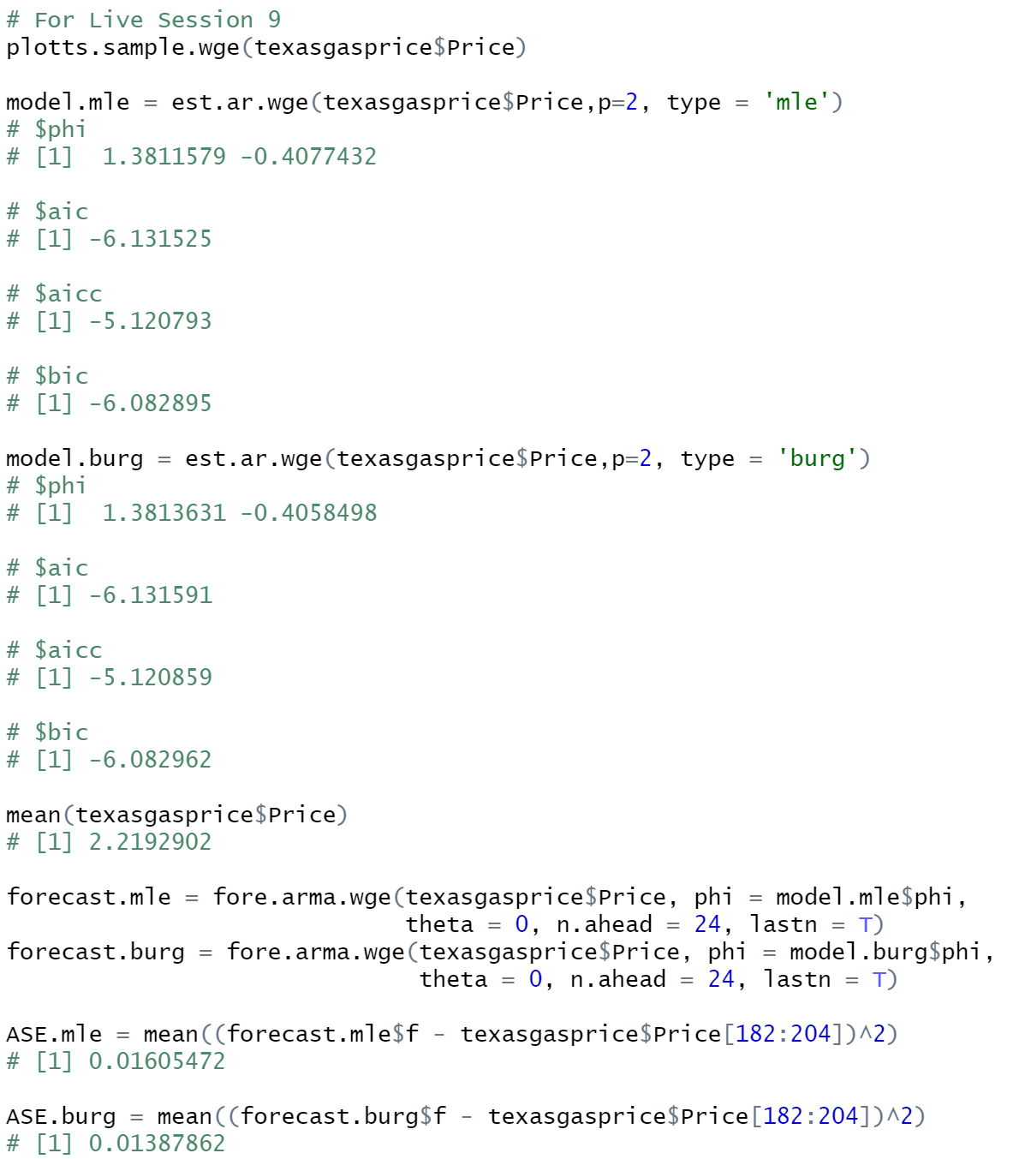





Fit an AR(2) to the data using the maximum likelihood estimates
Based on the output, it appears the package is recommending 1.3811579 and -0.4077432 as the phi values.
Using those phi values, the AIC is -6.131525 and the BIC is -6.082895

Slide 3





Fit an AR(2) to the data using the Burg estimates. Display and describe.
Interestingly enough, we can see the phi values are very close to those of the MLE output in the previous slide. In fact, if round high enough, the values would be identical.
The same could be said about the AIC and the BIC. No mean was added back to the data since a zero-mean was not assumed.

Slide 4
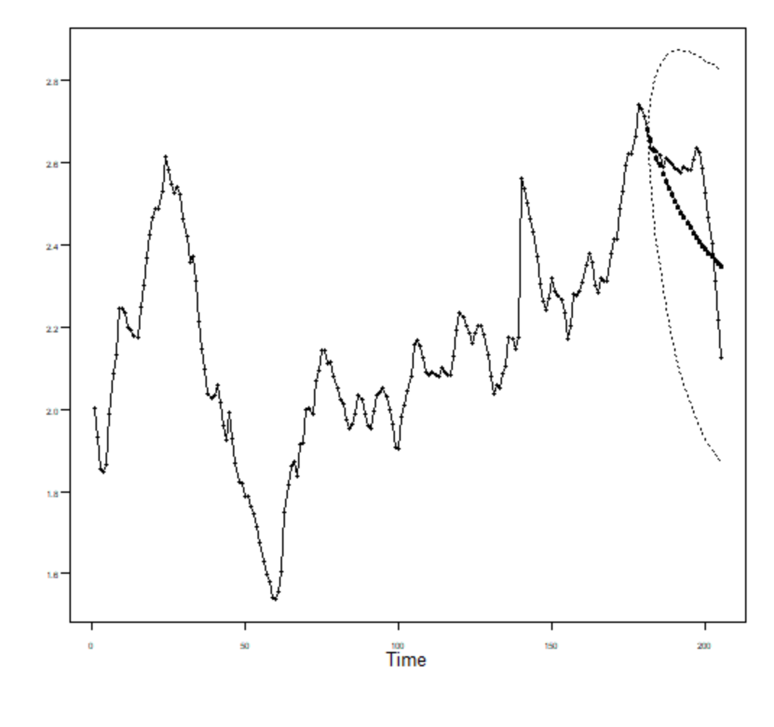
Find the ASE for the maximum likelihood fit by forecasting the last 24 weeks of the series.

Slide 5

Find the ASE for the Burg fit by forecasting the last 24 weeks of the series.

Slide 6
Which model would you choose?
Considering the models are nearly identical, I believe either model could be a solid choice. However, considering the ASE demonstrated a difference at the hundredths level, I would consider the burg model. The AIC and the BIC were too close to feel comfortable making the decision solely on those elements. However, in this exercise we were restricted to a simple AR(2) model, which may not necessarily be the ideal model.
We saw their performance in the forecast output. Both models follow the same trajection and eventually resort back to the mean.

Slide 7
Key Takeaways & Questions
The biggest takeaways were that it is NOT recommended we use the Box-Jenkins and the Yule-Walker estimates. They are misleading and not the best metrics to be using.
We must follow 4 steps as we go through this process:
Check for white noise
Estimate p and q
Use p and q estimates to check for estimates of phi and theta
Fit and Forecast

